Slide 1
STANFORD SUMMER RESEARCH COLLEGE • POLITICAL SCIENCE RESEARCH LUNCH • JULY 2026
Identity Politics and Teacher Selection
How Cultural Conflicts and Restrictions Influence US Teachers
Roxanne Rahnama (Stanford) • Tyler Simko (University of Michigan) • Elisa Wirsching (LSE)
Jayden Song
Notes:
Welcome + introduce yourself: you are the RA on this project working with Prof. Rahnama and coauthors at Michigan and LSE. Your main lane is the outcome-side data — collecting and processing state teacher rosters — but today you'll walk through the whole project: the theory, both sides of the data pipeline, and where the analysis is headed. ~45 minutes of content, then questions. Emphasize this is an active working paper: some results are still being estimated, so you'll present design and descriptives rather than final findings.

Slide 2
Today
1
Motivation & theory
Why cultural conflict might reshape who teaches — a non-material cost story
2
Measuring conflict
Four national datasets → a district-year panel of discretion-restricting incidents
3
Measuring teachers
My summer: FOIA campaigns, messy rosters, LLM harmonization, voter-file linkage
4
Testing the argument
How the team plans to take this to the data — still in development
5
Wrapping up
Contributions and next steps
Notes:
Give the audience the shape of the talk: about 10 minutes each on motivation/theory, treatment data, outcome data (your section — the longest), design, and next steps + Q&A. Flag now that the punchline is a design, not a result: the paper is at the stage where the dataset is the contribution so far.

Slide 3
MOTIVATION
The culture wars have come to the classroom
Cobb County, GA — 2022
Washington Twp., NJ — 2022
Coeur d'Alene, ID — 2025
District enacts a “Parents' Bill of Rights” letting parents object to any instructional material a teacher recommends.
Board votes 8–1 to remove Toni Morrison's The Bluest Eye from English courses after a parent complaint.
District pulls 150 books “for review” following parent complaints — librarians and English teachers directly implicated.
These are not just electoral or rhetorical fights. A growing literature shows polarized conflict can degrade institutional capacity through human capital — cumulative shifts in who exits, who enters, and what workforce remains.
Hopkins 2018; Brown et al. 2026; Gailmard & Gailmard 2026; Wirsching 2026
Notes:
Open with concrete cases — these are real incidents from the project's data. The point: schools, once thought insulated from partisan conflict, are now front-line sites of symbolic contestation (Hopkins 2018 on nationalization). And these fights don't just change curricula — they may change WHO is willing to keep teaching.

Slide 4
THE QUESTION
How do cultural conflicts reshape
bureaucratic labor markets?
Existing accounts of public-sector selection are anchored in material factors — pay, pensions, discrete institutional shocks. What's undertheorized: how conflicts over values and identity operate on the deeper motivations that draw workers to public service in the first place.
Notes:
Frame the gap: prior work on why bureaucrats stay or leave centers on material accounts — salaries, pensions, layoffs — or discrete institutional shocks. But teachers famously don't teach for the money. If cultural conflict attacks the non-material rewards of the job, standard models miss the mechanism entirely. That's the theoretical opening.

Slide 5
MOTIVATION
The stakes: teachers are where most Americans meet the state
5.4M
~8%
#1
Americans teach in
K–12 public schools
of the college-educated
labor force
largest group of “street-level
bureaucrats” in the country
Downstream: teachers shape both educational outcomes (Chetty, Friedman & Rockoff 2014; Kraft et al. 2016) and the political socialization of youth (Sapiro 2004; Paglayan 2026). Conflict-driven selection into and out of teaching is therefore a question of state capacity.
Notes:
Teachers are the largest single group of street-level bureaucrats. Cite the big numbers, then the downstream logic: teacher quality drives student outcomes (Chetty et al. 2014) and schools politically socialize the young (Sapiro 2004; Paglayan 2026). So if cultural conflict systematically changes who stays in teaching, that has consequences for students and state capacity — not just for teachers.

Slide 6
THEORY
Theory, part 1: discretion is the job, not a perk of it
Street-level bureaucrats
Public service motivation
Workers who encounter citizens directly exercise judgment that is constitutive of the service itself — a teacher's choice of materials, a social worker's intervention, an officer's handling of a confrontation.
Lipsky 1980; Maynard-Moody & Musheno 2003
High-PSM workers draw intrinsic compensation from work experienced as meaningful, purposive, and identity-aligned — shaping recruitment, retention, and effort in ways wages alone cannot explain.
Perry & Wise 1990; Besley & Ghatak 2005; Gailmard & Patty 2007; Honig 2024
Professional discretion is a channel through which mission value is produced — and part of the pay.
Notes:
Two building blocks from public administration. (1) Lipsky's street-level bureaucrats: for teachers, cops, social workers, the discretionary judgment IS the public service product — it's constitutive, not just instrumental. (2) Public service motivation: these workers accept lower pay because the work feels meaningful and aligned with professional identity. Discretion is a channel through which that mission value gets produced. Set up: so anything that attacks discretion attacks the compensation package itself.

Slide 7
THEORY
The argument: cultural conflict as a non-material tax on the job
Stay while: wage + mission value (× PSM intensity) − discretion-reduction cost > outside option
A loose framework, not a formal model: when conflict shrinks discretion, it shrinks the mission-value term — the part of compensation money never covered.
Scope condition
The conflict must make professional discretion itself the object of restriction — contesting not only what workers may do, but whether their doing it was legitimate in the first place. A hostile climate or a resource cut is not enough.
Cultural conflicts = contests over “basic value orientations” and the “boundaries” of legitimate opinion — Hunter 1992; Jacoby 2014; Wildavsky 1987
Notes:
Core claim. Cultural conflicts — fights over basic value orientations and the boundaries of legitimate opinion (Hunter 1992; Wildavsky 1987) — impose a cost by eroding professional discretion. Walk through the stay/leave inequality informally: a worker stays while wage + mission value (weighted by PSM) minus the discretion-reduction cost beats the outside option. The scope condition matters: the conflict must target discretion ITSELF — contesting not just what workers may do but whether their doing it was ever legitimate — not merely create a bad climate or cut budgets. A budget cut is a material shock; a book ban is a public claim that your professional judgment has no standing.

Slide 8
THEORY
Two channels from conflict to cost
1
A signal about the value of your judgment
A restriction on culturally contested content is a public claim that the worker's expertise in her own domain is suspect or harmful — degrading meaning, mission value, and occupational prestige.
2
Moral injury and vigilance costs
Being required to withhold guidance one regards as professionally essential — or to self-monitor constantly for sanctioning risk — forces a gap between professional commitments and permitted conduct, displacing autonomous judgment.
When these costs outweigh the benefits, workers reconfigure their employment.
Rosso et al. 2010; Siegel 1971; Zacka 2017; Čartolovni et al. 2021
Notes:
Mechanism 1 is a status/signaling channel: when a district bans your materials, the environment frames your expert judgment as suspect or harmful — degrading meaning and occupational prestige (Rosso et al. 2010; Siegel 1971). Mechanism 2 is a moral-injury/vigilance channel: being required to withhold guidance you consider essential, or to act against your values, creates a gap between professional commitments and permitted conduct (Zacka 2017 on vigilance costs; the moral injury literature from healthcare). Both displace autonomous judgment and erode mission alignment — and when cost exceeds benefit, workers reconfigure their employment.

Slide 9
THEORY
Who bears the cost? Exposure × alignment
Directly exposed role
Less-exposed role
Maximum cost
Climate cost only
Ideologically misaligned
Discretion loss + values violated → highest predicted turnover
Environment moved against her values, but her own autonomy untouched
Buffered
Minimal cost
Ideologically aligned
Discretion formally reduced, but mandate experienced as validating
Neither domain nor values targeted
Notes:
This 2x2 is the analytical heart of the paper. Dimension 1: role-based exposure — does the conflict target YOUR professional domain? A book ban hits librarians and ELA teachers; the gym teacher shares the climate but not the direct discretion loss. Dimension 2: ideological alignment — is the conflict's direction congruent with your values? The mechanism is asymmetric: a teacher who endorses the restriction may experience it as validating, sustaining mission value even as formal discretion shrinks. The sharpest prediction sits in the top-left cell: exposed AND misaligned workers bear the maximum cost — a prediction that pure principal-agent misalignment stories do not generate.

Slide 10
THE CASE
Why teachers are the ideal test case
1
High-PSM “calling”
Salary is rarely the key driver of teaching careers; autonomy over instruction is core to job satisfaction and mission (Kraft & Lyon 2024; Dunn 2018).
2
Conflicts target discretion directly
Book bans, history mandates, and rules on gender in the classroom are public claims that teachers' professional judgment is harmful or misguided.
3
Exposure is measurable
Book bans → librarians & English • gender policies → health & PE • history mandates → social studies. Same school, same climate — different exposure.
Notes:
Three reasons rooted in the theory. (1) Teachers satisfy the preconditions: high-PSM workers for whom discretion is central — in one UK survey 58% cited making a difference in students' lives as their primary motivation vs. 16% citing salary. (2) Education's culture wars target instructional discretion DIRECTLY — book bans, curriculum mandates, rules on discussing gender are public claims that teachers' judgment is harmful. (3) Subject specialization makes within-school variation in exposure measurable: same district, same climate, different exposure — that's the identification lever.

Slide 11
THEORY → TESTS
Working hypotheses — still being revised
H1
Teachers are more likely to change employment in districts exposed to discretion-restricting cultural conflict than in comparable unexposed districts.
H2
Within conflict districts, teachers in directly-exposed roles change employment at higher rates than colleagues in less-exposed roles.
H3A
Among exposed teachers, those ideologically misaligned with the conflict's direction are the most likely to change employment.
H3B
Less-exposed but misaligned teachers may also respond — but to a smaller degree than exposed ones.
Notes:
Read these in ascending specificity. H1 is the district-level baseline. H2 adds the within-district exposure comparison. H3A/H3B add the ideology interaction — H3A is the maximum-cost cell prediction; H3B says even unexposed-but-misaligned teachers may respond (climate channel), just less. Together they trace exactly the 2x2 from earlier. Note for honesty: the paper marks these as possibly needing updates as the analysis matures.

Slide 12
PART 2 • TREATMENT DATA
Measuring cultural conflict
Four national datasets, one unified district-year panel of discretion-restricting incidents — with role exposure and ideological direction coded for every conflict.
Notes:
Transition: now the empirical machinery. First the treatment side — how the team turns thousands of scattered news stories, bills, and ban lists into a district-year panel with the two coded dimensions the theory needs: which roles each conflict targets, and which ideological direction it pushes.

Slide 13
TREATMENT DATA
Four sources, one conflict panel
CRT Forward (UCLA)
PEN America Book Bans
State & district anti-CRT measures across 45 states; legal databases + 4,000+ newspapers; proposed and enacted tracked.
Book-level restrictions with location, timing, status, and content — including permission requirements and “review” removals.
Hundreds of policies → 2024
July 2021 → present
Cato Battle Map
PEN Educational Gag Orders
Broadest net: conflicts over “basic rights, moral values, or individual identities” — catches what the others miss.
State legislation banning “divisive concepts” for K–12 teachers — overwhelmingly race, sexuality, gender identity.
2001 → 2024
2021 → 2025
Incidents de-duplicated across sources; state-level panels built where policies apply statewide.
Notes:
One card per source. CRT Forward (UCLA Law): several hundred state and district anti-CRT measures across 45 states, built from legal-database searches plus screening of 4,000+ newspapers; tracks proposed AND enacted. PEN Book Bans: book-level restrictions from July 2021 on, including soft censorship like parental-permission requirements. Cato Battle Map: the broad net — conflicts over 'basic rights, moral values, or individual identities,' 2001–2024, catching things the others miss (e.g., a 2016 Ohio district scrubbing intelligent design from science). PEN Gag Orders: state-level 'divisive concepts' legislation 2021–2025, mostly race, sexuality, gender identity. Incidents are de-duplicated across sources before analysis.

Slide 14
TREATMENT DATA
Not all conflict binds: enacted vs. contested-only
Enacted
Contested only
A binding measure reaches classroom staff — a book removed, a curriculum mandated, a policy adopted or revised. Discretion is actually reduced.
Protest at a board meeting, a failed proposal, a challenge voted down. Staff may update beliefs about their environment — but no rule changes.
Predicted: strongest staff response
Effectively a placebo — nothing new for teachers to implement
Cato lacks outcome fields → LLM classification of event descriptions determines whether a policy change occurred (Appendix A).
Notes:
Why this coding matters theoretically: a failed book-ban attempt may still teach bureaucrats about their environment, but it is categorically different from a ban that actually strips discretion. Per the PIs: contested-but-not-enacted incidents function essentially as a placebo — nothing actively changes teachers' discretion or requires implementation — so enacted-vs-not is a sharp testable margin. Three sources record outcomes natively; Cato doesn't, so the team uses LLMs on event descriptions to classify whether a policy change occurred (detailed in Appendix A).

Slide 15
TREATMENT DATA
Coding each conflict: who's targeted, and in which direction
Role exposure
Ideological orientation
Library book removals
→
Librarians, English/LA
Conservative
Ban restricting LGBTQ+ reading material is enacted
Locker-room / gender policies
→
Coaches, Health & PE
Liberal
Policy grants locker-room access by gender identity
History curriculum mandates
→
History / Social Studies
Neither
Teacher dismissed for misconduct — no ideological direction
Not a claim that others are unaffected — only that one group is most directly implicated.
Coding = manual hand-coding + LLM assistance, with examples and prompts in Appendix B.
Final step: aggregate to a district-year conflict panel with staff impact, exposure, and ideology features.
Notes:
Two labels per conflict, produced by a mix of hand-coding and LLMs (Appendix B). Role exposure: which of the ten roles / eight subjects the conflict most directly implicates — library-book restrictions hit librarians, locker-room policies hit coaches. Important caveat the paper makes: nobody claims unexposed groups are unaffected — the gym teacher still experiences a disrupted workplace — the claim is only about identifying the MOST directly impacted group. Ideological orientation: conservative (e.g., restricting LGBTQ+ reading material), liberal (e.g., gender-identity locker-room access), or neither (e.g., a teacher fired for misconduct — culture-war adjacent but directionless).

Slide 16
PART 3 • OUTCOME DATA — MY WORK
Building the teacher panel
Public-records campaigns in all 50 states, millions of messy roster rows, LLM-based harmonization, and voter-file linkage — the part of the project where my summer lives.
Notes:
This is your section — slow down and own it. Frame: the theory is only testable if you can observe every public-school employee, know what they teach, follow them across years and districts, and attach an ideology measure. None of that exists off the shelf. The next six slides are how the team — and your summer — builds it.

Slide 17
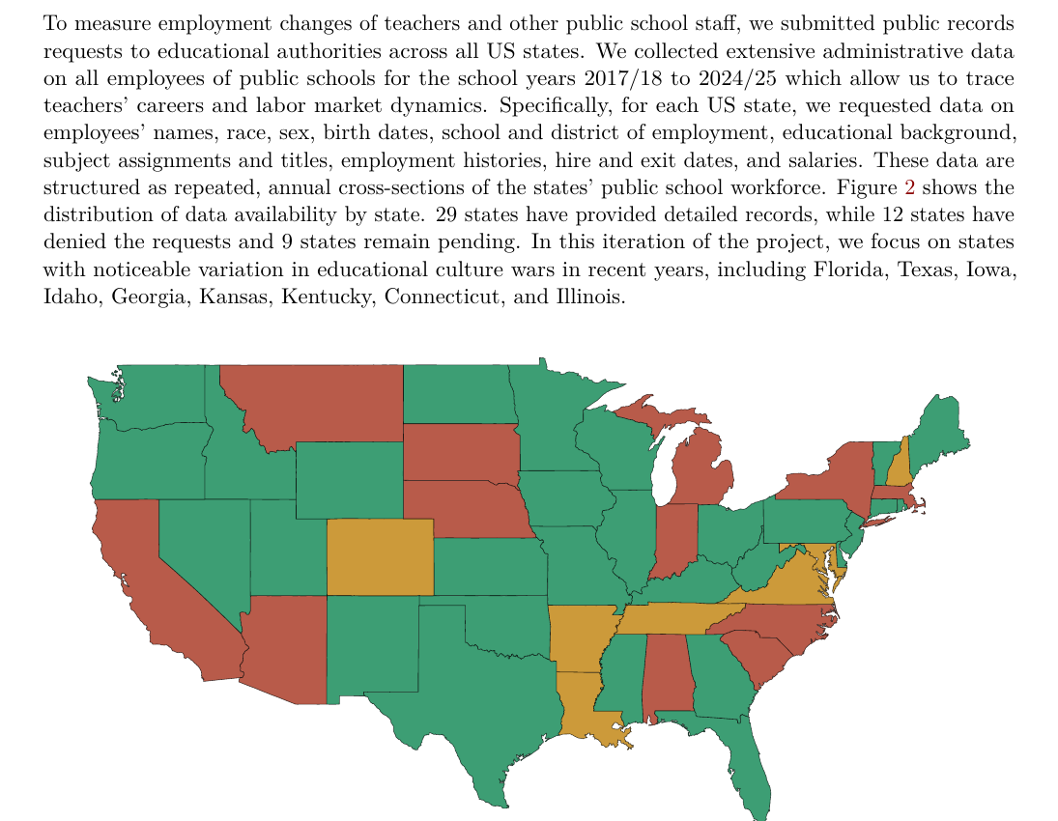
OUTCOME DATA
Step 1: public records requests to all 50 states
29
states delivered complete records
12
declined (collection continues)
9
requests still pending
Focus states this round: FL, TX, IA, ID, GA, KS, KY, CT, IL — chosen for variation in educational culture wars.
School years 2017/18 – 2024/25 • annual cross-sections of the full public-school workforce
Notes:
Explain the ask: for every state, employee-level administrative records for school years 2017/18–2024/25 — names, race, sex, birth dates, school and district, education, subject assignments and titles, employment history, hire/exit dates, salaries — structured as annual cross-sections of the entire public-school workforce. Current status: 29 states complete, 12 declined, 9 pending; collection continues through other channels for decliners. This iteration focuses on states with real culture-war variation: FL, TX, IA, ID, GA, KS, KY, CT, IL. War stories welcome here: fee negotiations, redaction fights, formats from clean CSVs to scanned PDFs.

Slide 18
OUTCOME DATA
What the raw rosters actually look like
KS
ENG / LA Arts READING
Three encoding regimes
IL
GEOMETRY (REG+HONORS)
Packed titles — role + subject in one free-text field (FL, IL)
Split fields — separate role and subject columns (KS, IA)
Entangled — several roles & subjects per record (KY, ID)
GA
Music_XX_BAND_CHORUS_LVL2
GA
Librarian/Media Specialist • Library/Media Secretary/Clerk
KY
Media Librarian
Same job, five spellings — and millions of staff-year rows. Manual coding doesn't scale.
Notes:
This slide earns the harmonization step. Every state encodes roles differently: some pack role AND subject into one free-text title (Florida, Illinois), some split them across separate fields (Kansas, Iowa), some entangle several roles and subjects in one record (Kentucky, Idaho). Show the librarian example: Georgia alone uses 'Librarian/Media Specialist' and 'Library/Media Secretary/Clerk'; Kentucky says 'Media Librarian.' You cannot regex your way through millions of rows of this. That's the motivation for the classification scheme on the next slide.

Slide 19
OUTCOME DATA
A common language: 10 positions × 8 subjects
Position indicators (10)
Subject-exposure indicators (8)
teacher • substitute • librarian • counselor • coach / extracurricular • special education • support staff • superintendent • admin • other
Role-based flags are read from role text and observed in every state — never missing.
English / LA • History / Social Studies • Health & PE • Science • Arts & Music • Math • World Languages • Other subject
Each subject is a culture-war front: book bans → English/LA; curriculum mandates → History; gender & sex-ed conflicts → Health/PE.
Scheme developed inductively by iterating between roster titles and conflict descriptions — one vocabulary for both sides.
Notes:
The scheme was developed inductively by iterating between the roster data and the conflict data — so the same categories describe both who a conflict targets and who each staff member is. Every one of the ~2.3M staff in the sample gets multi-label flags. The eight subject categories map onto culture-war fronts: english_la for book bans, history_social_studies for curriculum mandates, health_pe for gender/sex-ed conflicts, and so on. Position flags (librarian, counselor, coach, special-ed) are always observed; subject flags can be missing where states don't record subjects.

Slide 20
OUTCOME DATA
Classifying millions of rows without reading millions of rows
1
Concatenate
2
Deduplicate
3
Classify
4
Merge back
All role/subject columns → one delimited descriptor string per row
→
Hundreds–thousands of unique descriptors per state — not millions of rows
→
LLM batch → multi-label flags: 1 / 0 / missing per category
→
Flags rejoin every roster row sharing the descriptor
Model: Gemini 2.5 Flash (batch) • validated against an independent Claude run • pipeline is model-agnostic
Careful inputs: certified/classified status prefixed to descriptors • certifications excluded — licensed-to-teach ≠ actually teaches
Cost scales with the vocabulary of job titles — not with millions of staff-year rows.
Notes:
The engineering trick: classification runs on UNIQUE descriptors, not rows. Concatenate every role/subject column into one delimited descriptor string per row; the set of distinct descriptors per state is only a few hundred to a few thousand, so cost scales with vocabulary, not with millions of staff-years. The classifier (Gemini 2.5 Flash via batch, validated against an independent Claude run — the pipeline is model-agnostic) returns multi-label 1/0/missing flags per descriptor, which merge back onto every matching row. Design details that matter: certified-vs-classified prefixes so identical titles are classified separately by status; and certifications/endorsements deliberately EXCLUDED — they record what someone is licensed to teach, not what they teach, and would bias subject flags.

Slide 21
OUTCOME DATA
Design philosophy: a real zero is not a missing value
Err toward false negatives
0 ≠ missing
Insufficient title information → classification left missing, never guessed. Consistency across states beats coverage within any one state.
A record contributes a 0 to a subject only when positively assessed as teaching some other subject. “No subject data” is never read as “not this subject.”
GA & KY record no subject field → core academic subjects returned as missing there, by design.
Verification pass: descriptors scanned for category keywords per state — intended missingness is checked before a classification is accepted.
The exposure comparisons only mean something if a “not exposed” label is trustworthy.
Notes:
Two disciplined choices. First, precision over recall everywhere: when titles are too vague, leave the classification missing rather than guess — err toward false negatives. Second, the subject flags distinguish 'assessed and not this subject' (0) from 'no subject information exists' (missing): a record only contributes a 0 to English if it was positively assessed as teaching something else. Concrete consequence: Georgia and Kentucky record no academic-subject field at all, so core subjects are missing for ordinary classroom teachers there — role flags stay fully identified. And there's a verification pass: before accepting a state's classification, descriptors are scanned for category keywords, and a category with no signal anywhere in a state is expected to be entirely missing there — intended missingness is checked, not assumed.

Slide 22
OUTCOME DATA
Attaching ideology: probabilistic linkage to the L2 voter file
1
Block
First-name clusters + sex + birth year — shrink the comparison space
2
Match
First name, last name, date of birth (Fellegi–Sunter posterior)
3
Threshold
Keep pairs with posterior match probability ≥ 0.85
4
Geo filter
Voter's county within 150 miles of a district of employment
5
Uniqueness
≤ 1 voter per employee; ties dropped as unresolved
Deliberately precision over recall: better to lose a common-name match than to assign the wrong partisanship. • L2 universe 2014–2025 • Enamorado, Fifield & Imai (2019, APSR)
Notes:
The ideology measure comes from matching every school employee to the universe of US registered voters, 2014–2025 (L2), via probabilistic record linkage in the Fellegi-Sunter framework (Enamorado, Fifield & Imai 2019). Walk the safeguards: blocking on first-name clusters (plus sex and birth-year where available) to make it computable; matching on first name, last name, DOB; retain pairs with posterior match probability ≥ 0.85; then a geographic filter — voter's county must be within 150 miles of a district where the employee worked; finally, one voter per employee max, with ties dropped as unresolved. Explicit tradeoff: this prioritizes precision over recall, guarding against false positives for common names — better to lose a John Smith than to assign him the wrong party.

Slide 23
OUTCOME DATA
Defining the outcome: three margins of turnover
1
2
3
Moved schools
Moved districts
Left the workforce
Changed schools within the same district
Changed school districts in the same position
Exited the state public-school workforce entirely
Note: moving schools within the same district may function as something of a placebo margin relative to the sharper exit outcomes.
Notes:
With staff followed across annual snapshots, each teacher-year gets coded on three margins relative to the prior year. Note the honest caveat on margin 3: 'left the state workforce' bundles leaving the profession, moving to private schools, and moving out of state — but some states (Iowa) include private schools in the roster, which lets the team unbundle it partially. Per the PIs: within-district school moves may act as something of a placebo margin relative to the sharper exit outcomes.

Slide 24
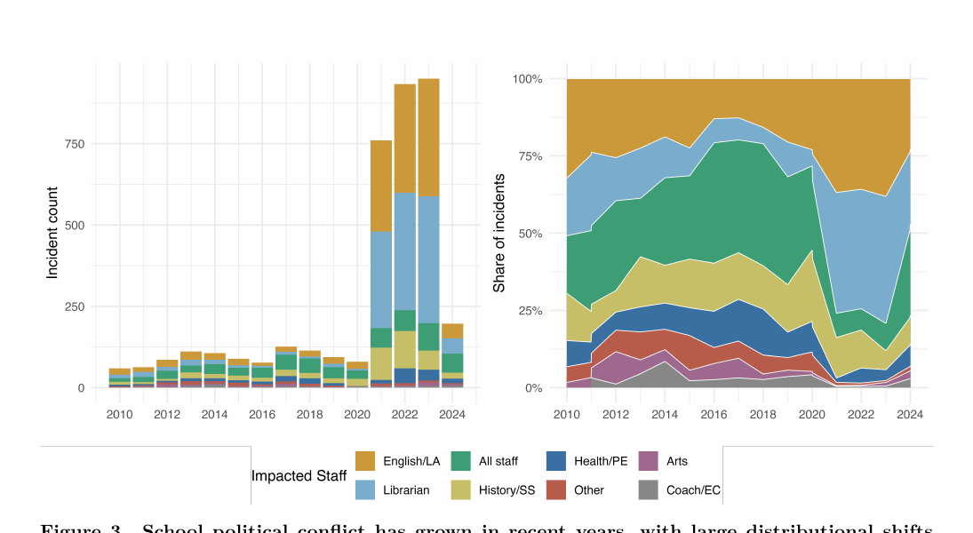
DESCRIPTIVES
What the conflict panel shows so far
School political conflict has grown sharply — with a distributional shift toward librarians and reading/literary instruction.
Figure: district-level conflict incidents across the three district-level sources (working draft).
Notes:
First descriptive output of the merged panel. Left: district-level conflict incidents have surged in recent years. Right: the composition has shifted — a growing share of conflict primarily implicates librarians and reading/literacy instruction, consistent with the book-ban wave post-2021. This is what makes the exposure design promising: the treatment isn't just growing, it's growing UNEVENLY across roles. If estimation strategy comes up: the authors are using TWFE and triple-difference designs and have created matched pairs of treated and control teachers — details still in development, so keep it at that level.

Slide 25
CONTRIBUTIONS
Three intended contributions
1
2
3
Bureaucratic politics & state capacity
Teacher labor markets
Comparative politics of education
How this contribution is framed is still being developed by the research team.
First large-scale causal evidence on policies that differentially target discretion within the same institution — beyond pay, tenure, and uniform accountability reforms.
A within-democracy parallel to cross-regime findings: politicizing the teaching career via cultural conflict → self-selection out, not formal hiring & firing.
Speaks to: Richardson 2019; Spenkuch et al. 2023; Gailmard & Gailmard 2026 • Biasi 2021; Kraft et al. 2020 • Paglayan 2026
Notes:
One per literature. (1) Bureaucratic politicization & state capacity: beyond principal-agent misalignment and management shocks, a third mechanism — conflicts that contest whether the work is legitimate — with the distinctive prediction that turnover concentrates among opposed workers in exposed roles. (2) Teacher labor markets: prior work studies pay, tenure, working conditions, or accountability reforms applied uniformly; this is the first large-scale causal evidence on policies that DIFFERENTIALLY target discretion within the same institution. (3) Comparative educational politicization: Paglayan shows autocracies politicize the teaching career itself; this paper is the within-democracy parallel — in an established democracy, politicization can operate through cultural conflict that induces self-selection out, rather than formal political hiring and firing.

Slide 26
LIMITATIONS
Honest limitations (ask me about these)
Selection into data
12 states declined records — refusal may correlate with culture-war intensity; alternative channels ongoing
Preliminary throughout
Hypotheses, specifications, and coding schemes are all still being refined by the PIs
Unobserved outside options
Next-best alternatives can't be measured directly; mobility proxies + NTPS (if granted) help
Measurement of treatment
Conflict trackers differ in method and scope; LLM coding validated across models but automated
The panel sees employment changes — not their reasons. That's what the interviews are for.
Notes:
Preempt the smart questions. Coverage: 12 states declined records requests — if refusal correlates with culture-war intensity, that's non-random missingness; alternative collection channels continue. If matching/linkage questions come up: note it is Elisa's area of the project and the design is deliberately precision-first — do not volunteer it as a limitation. Outside options are unobservable at the individual level — mobility proxies (age, experience, subject) moderate, and NTPS attitudinal data, if access is granted, could separate the felt cost from the acted-on response. Measurement: treatment relies on advocacy-adjacent trackers (PEN, Cato, UCLA) with different methodologies; the LLM role classification is validated across models but still automated coding. And the panel observes employment changes, not their reasons — that's exactly what the interview arm is for.

Slide 27
NEXT STEPS
Where the project goes from here
1
Complete the map
2
Estimate
Resolve 9 pending states; alternative collection for the 12 decliners
Main triple-difference specifications + enacted × alignment heterogeneity
3
Field interviews
4
Extend
Stratified interview outreach across the 19 selected districts
NTPS attitudinal data (pending access) to separate felt cost from acted-on exit
Working paper — feedback on design, measurement, and framing especially welcome.
Notes:
Close with momentum: (1) resolve the 9 pending states and pursue alternatives for decliners; (2) finalize the harmonized panel and estimate the main triple-difference specifications; (3) field the stratified interviews in the 19 selected districts; (4) pursue NTPS attitudinal data to connect the felt cost to observed exit; (5) draft findings and circulate. Then invite questions — and offer to go deep on any piece of the data pipeline, since that's the part you know cold.

Slide 28
Thank you
Questions — especially about the data pipeline — very welcome.
Framework, classifications & design (in progress): Rahnama • Simko • Wirsching | Roster data collection & processing: Jayden Song
Stanford Summer Research College • Political Science Research Lunch • July 2026
Notes:
Thank the audience and your PIs. Good closer: 'My job this summer was to make sure that when the theory meets the data, the data can hold up its end.' Then open the floor — you're strongest on the FOIA/roster/linkage material, so steer detailed questions there, and note that theory or estimation questions can also be relayed to the research team.

